Slide 1
Presentation on BusTopologies
Presented By :MD. ANISUR RAHMAN
ID NO.: 1202992
Bach Id :ID_NT/ACSL-01M/R28/01
Student of Network Technology
Round-28 IDB BISEW

Slide 2
What is a network topology?
In communication networks, a topology is a usually schematic description of the arrangement of a network, including its nodes and connecting lines.
There are two ways of defining network geometry: the physical topology and the logical (or signal) topology.

Slide 3
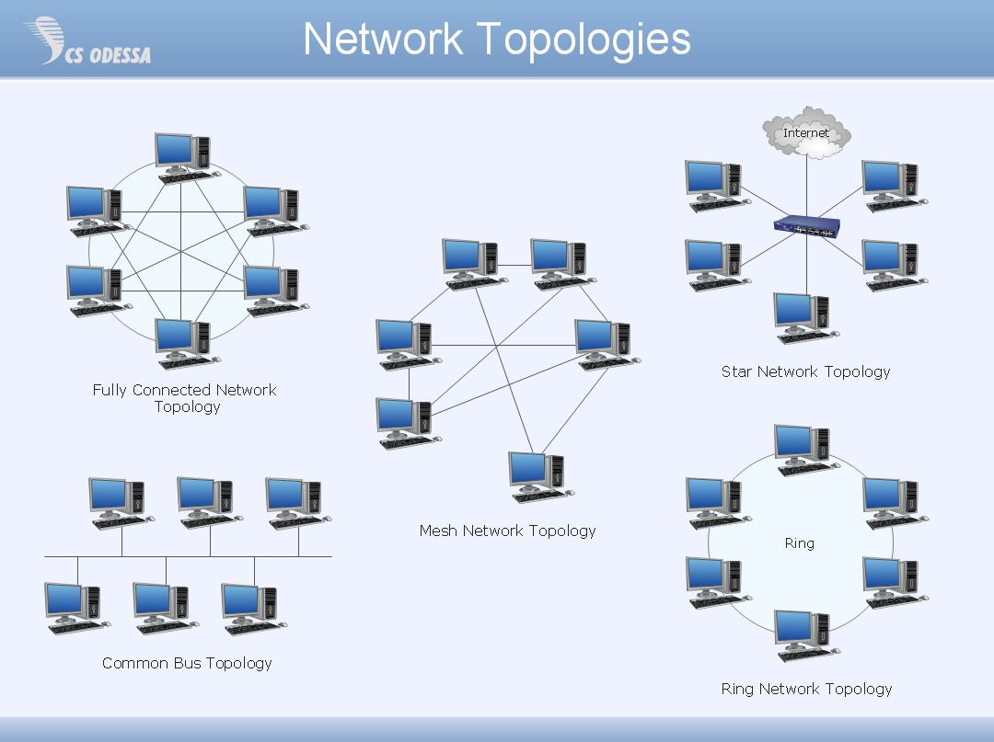

Slide 4
BUS Topology
Bus topology is a network type in where every computer and network device is connected to single cable.
The bus topology consists of two distinct and terminated ends.

Slide 5
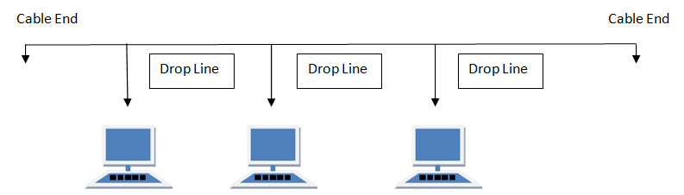
The image of Bus Topology :

Slide 6
Features of Bus Topology
1. It transmits data only in one direction.
2. Every device is connected to a single cable

Slide 7
Advantages of Bus Topology
It is cost effective.
Cable required is least compared to other network topology.
Used in small networks.
It’s easy to install.
It is easy to understand.

Slide 8
Disadvantages of Bus Topology
Cables fails then whole network fails.
Cable has a limited length.
It is hard to troubleshoot, change or move.
It really doesn’t offer much in the way of fault tolerance because everything is connected to single cable.

Slide 9
Thank you for watching

